Slide 1
Get Your Job data
@Indeed.com via scrapy data & EDA
Drace Zhan
dracezhan@gmail.com
https://www.linkedin.com/in/dracezhan
https://twitter.com/DraceZhan
https://github.com/DraceZhan/

Slide 2
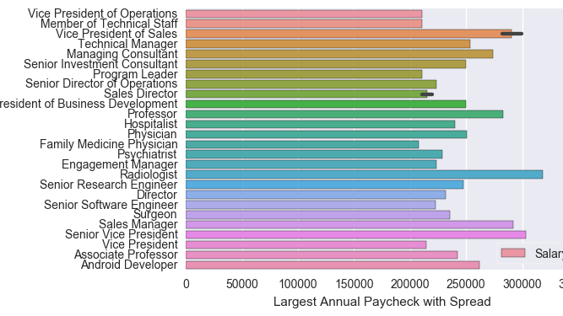
Which job listings pay best?
(I hope you want to be a radiologist…)

Slide 3
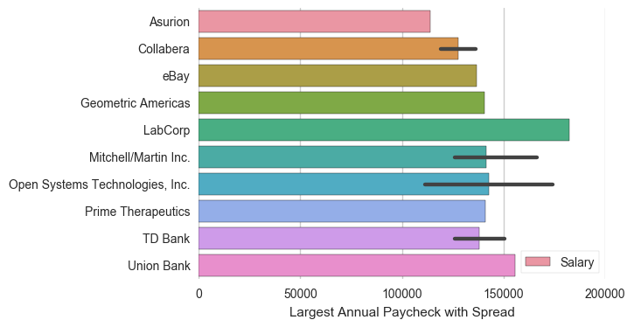
Companies that will pay you money
(Banks, tech, and internets)

Slide 4
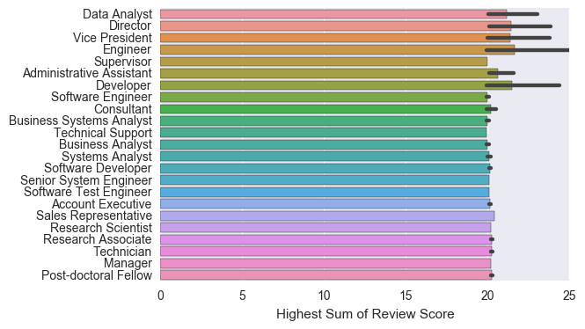

People who like their jobs
(nerds who tell people what to do)

Slide 5
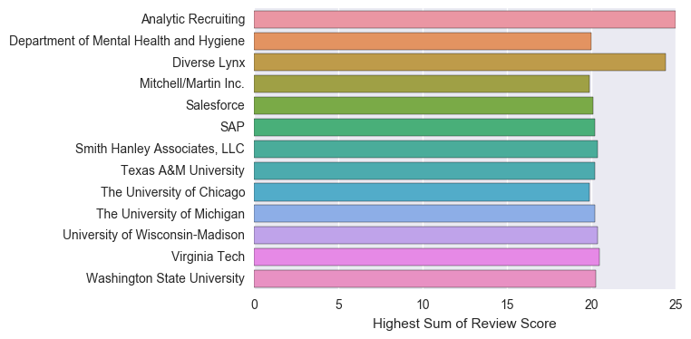

Places to Be
(Schools of not-so-hard knock)

Slide 6
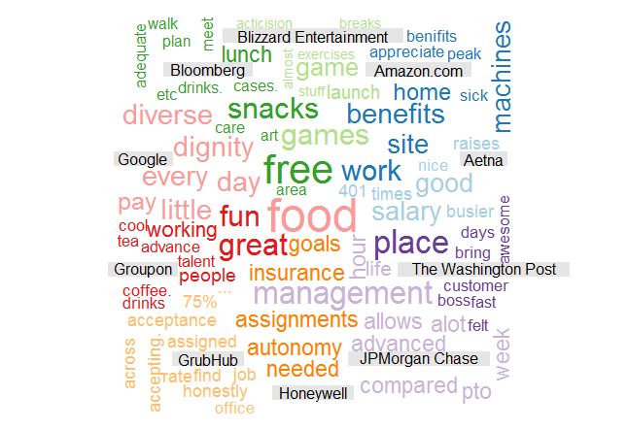
Wordcloud of What People Like

Slide 7
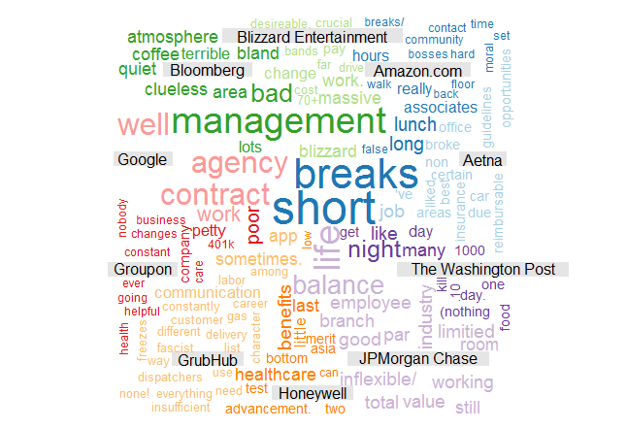
Wordcloud of What People Hate

Slide 8
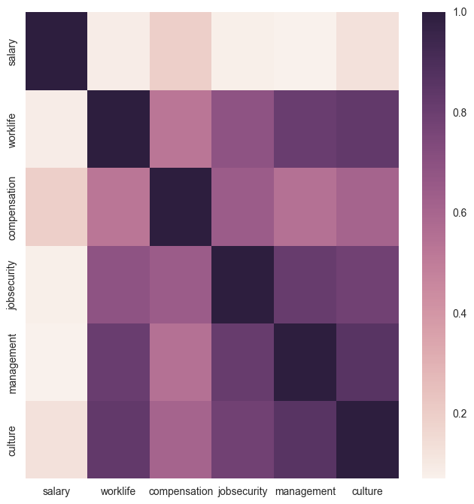
And now for some data modeling ...

Slide 9

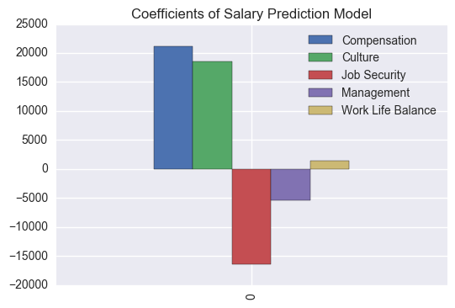
When Salary goes up ...
Job Security goes down

Slide 10
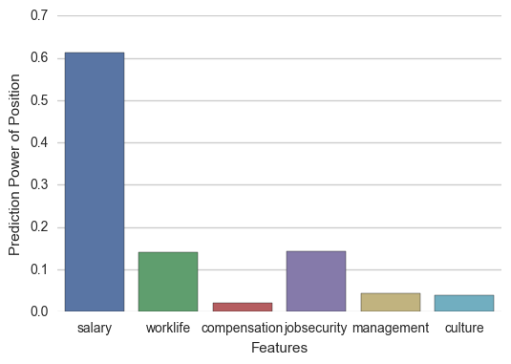
What gets the job?
(according to a random forest depth of three …)

Slide 11
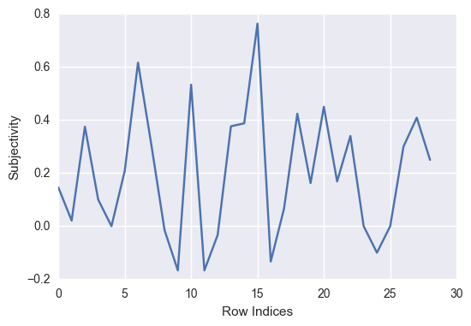
What People think about working at Washington Post
Subjective & Polarity through reviews via Textblob NLP

Slide 12
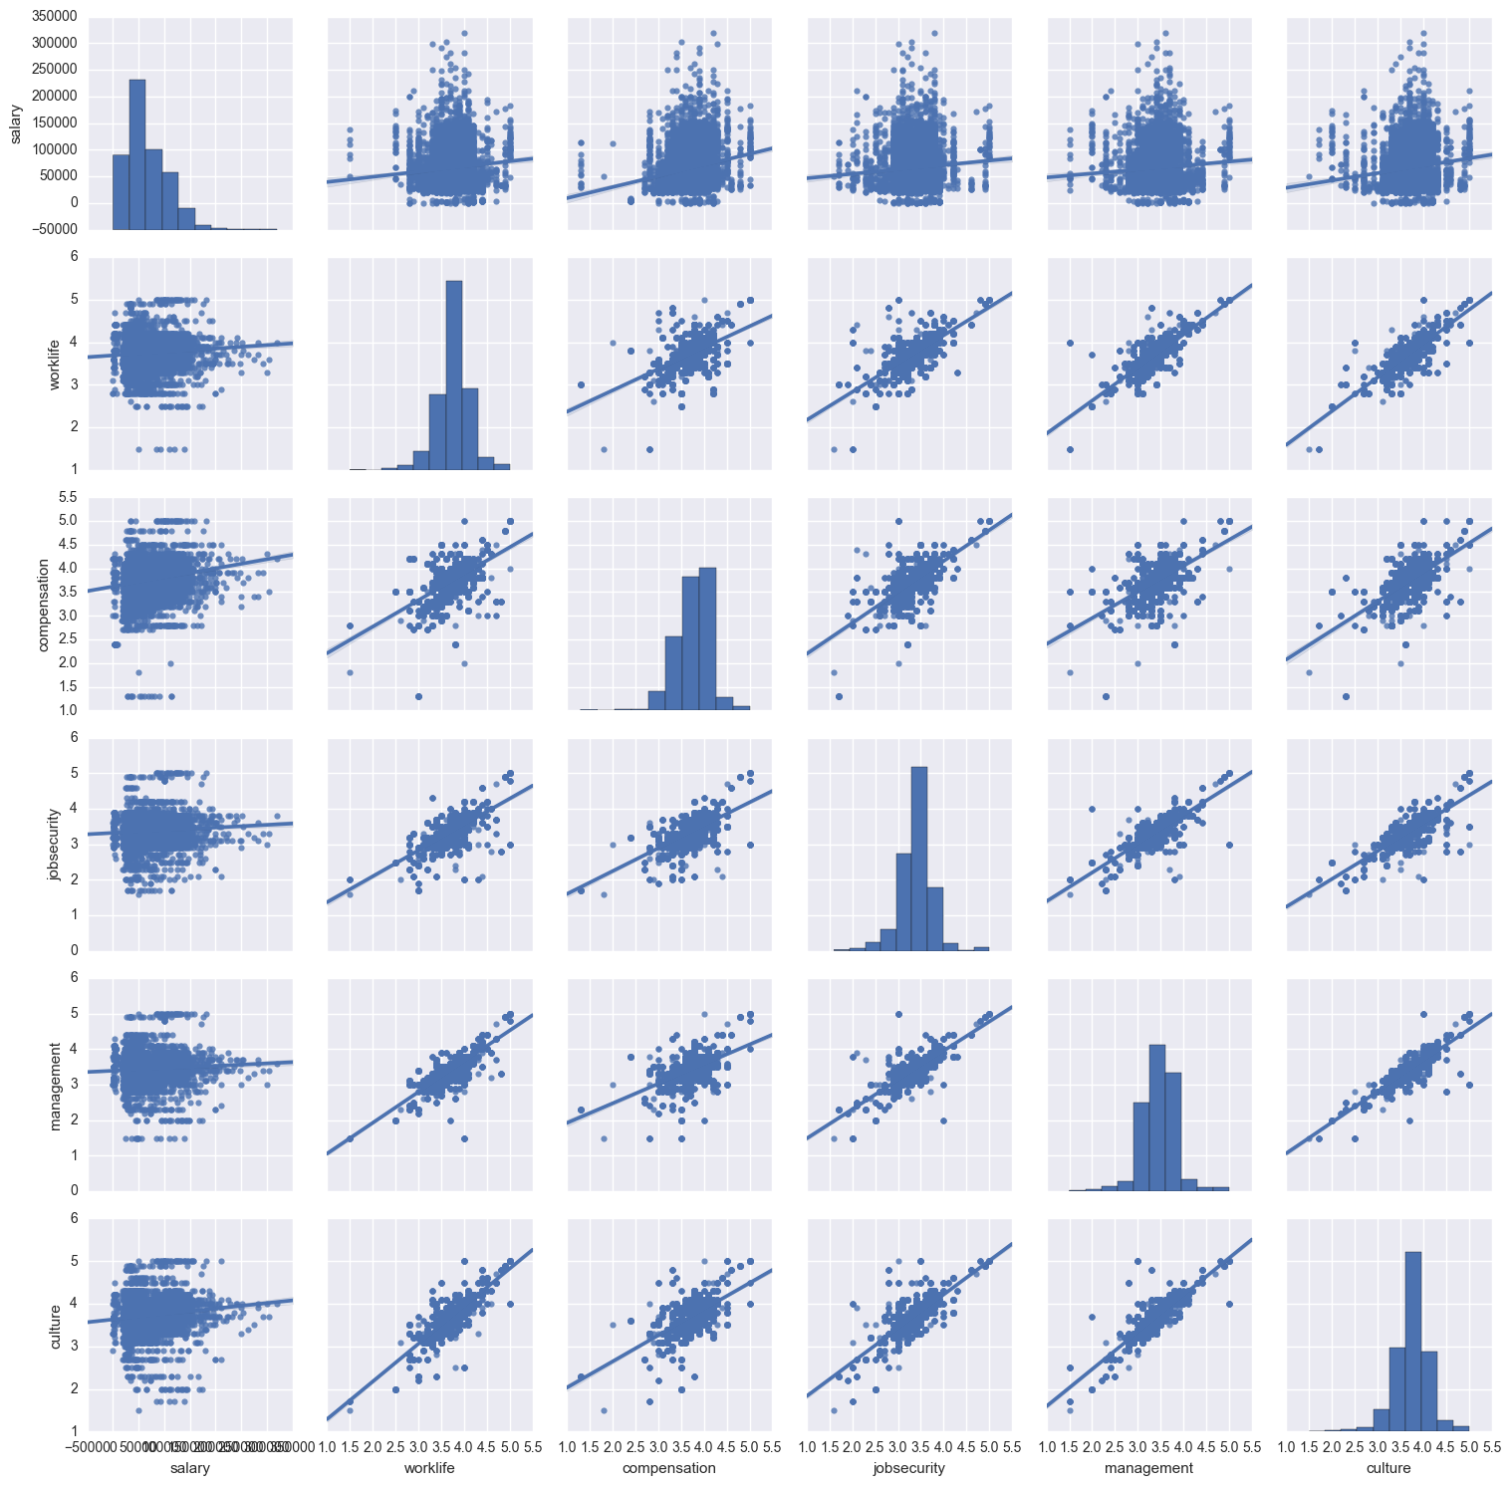
Additional Plots & Thoughts for the future analysis …
Pair Plot with linear regression of salary versus variables examined in linear regression model earlier.

Slide 13
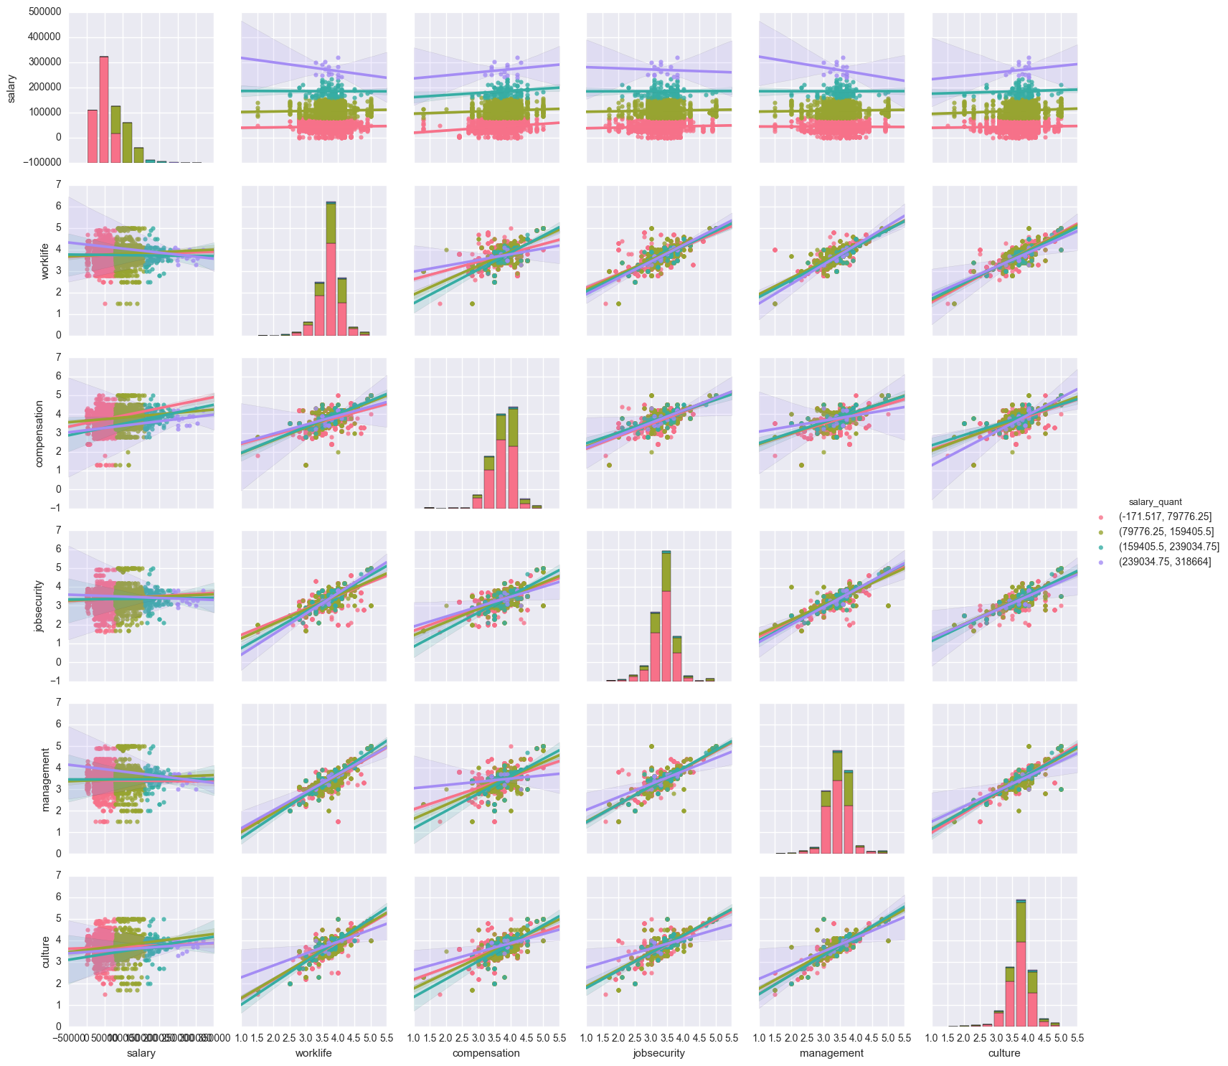
Same variables but now cut across four salary quantiles. Notice that large quantiles cause significant errors. If we eliminate the largest salary quantile, it should lead our model predicting more accurately but with significant loss of data.
Also there appears to be more to explore in terms of relationships between the review genres than reviews vs salary.

